Slide 1
Healthcare Informatics
Symptom-Based Disease Prediction System Using Machine Learning

Slide 2
Introduction
Traditional manual diagnosis in healthcare is time-consuming, error-prone and can lead to delayed treatment.
There's a important need for a more efficient and reliable technique for disease prediction using machine learning and healthcare informatics to enhance diagnostic accuracy and efficiency.
The symptom-based disease prediction system using machine learning aims to address these challenges by developing a novel solution that predicts disease based on patient-reported symptoms.
The project seeks to reduce the workload on medical professionals, streamline diagnostic workflows and facilitate timely treatment interventions.

Slide 3
Problem Statement
The existing healthcare system heavily relies on manual diagnosis that is time-consuming, error-prone and can result in delayed treatment. This manual procedure also places a considerable load on medical professionals. There is a critical requirement for a more efficient and reliable technique for illness prediction based on symptoms that uses machine learning and healthcare informatics. The aim of this research is to create a machine learning-based system that can reliably forecast illnesses using symptoms supplied by patients. This method intends to increase the efficiency and accuracy of illness diagnosis.

Slide 4
Motivation
The motivation behind this project stems from the inefficiencies and challenges present in the current manual diagnostic process in healthcare. We seek to enhance diagnostic accuracy and improve patient outcomes and healthcare efficiency using machine learning and healthcare informatics, .
Develop a machine learning model that can accurately predict diseases based on symptoms provided by patients.
Integrate the prediction system into existing healthcare systems to assist healthcare providers in making faster and more accurate diagnoses.
Improve patient outcomes using early detection and treatment of diseases.

Slide 5
Literature Survey
Maniruzzaman et al. conducted a study on the classification and prediction of diabetes disease using machine learning techniques. The research explored various algorithms for diabetes prediction
Ali et al. focused on heart disease prediction using supervised machine learning algorithms. The study analyzed and compared the performance of different algorithms in predicting heart disease.
Ali et al. proposed a smart healthcare monitoring system for heart disease prediction using ensemble deep learning and feature fusion techniques. Their research demonstrated the effectiveness of integrating advanced machine learning models with healthcare data for accurate prediction of heart disease.

Slide 6
Traditional Approach
In the traditional healthcare approach diagnosis relies on manual processes conducted by healthcare providers. They gather information through patient history, physical examination and diagnostic tests. Diagnosis is based on the provider's expertise and subjective interpretation of symptoms and clinical findings. This approach is prone to human error, variability and can be time-consuming. There is need to augment traditional methods with technological advancements like machine learning to improve diagnostic accuracy and efficiency.

Slide 7
Proposed Challenges
The proposed approach using machine learning and healthcare informatics to revolutionize disease prediction. Patient-reported symptoms are inputted into a machine learning system trained on vast datasets. This system uses advanced algorithms to analyze and interpret symptoms, identifying patterns and associations indicative of various illnesses. The proposed approach aims to provide accurate and timely predictions of diseases. This data-driven approach offers the potential to enhance diagnostic accuracy compared to traditional manual methods.

Slide 8
Dataset
The dataset comprises 375 rows with each row representing an individual's health profile and has attributes such as gender, age, occupation and various health-related metrics.
Key variables like sleep duration, quality, physical activity level, stress level, and BMI category offer insights into lifestyle choices and potential risk factors for health issues.
Vital health indicators like blood pressure and heart rate are included with daily step count, providing a comprehensive overview of an individual's physical health.
The dataset enables detailed analysis to uncover correlations between different factors and health outcomes
URL: https://www.kaggle.com/datasets/uom190346a/sleep-health-and-lifestyle-dataset

Slide 9
Dataset
The dataset comprises 375 rows with each row representing an individual's health profile and has attributes such as gender, age, occupation and various health-related metrics.
Key variables like sleep duration, quality, physical activity level, stress level, and BMI category offer insights into lifestyle choices and potential risk factors for health issues.
Vital health indicators like blood pressure and heart rate are included with daily step count, providing a comprehensive overview of an individual's physical health.
The dataset enables detailed analysis to uncover correlations between different factors and health outcomes
URL: https://www.kaggle.com/datasets/uom190346a/sleep-health-and-lifestyle-dataset

Slide 10
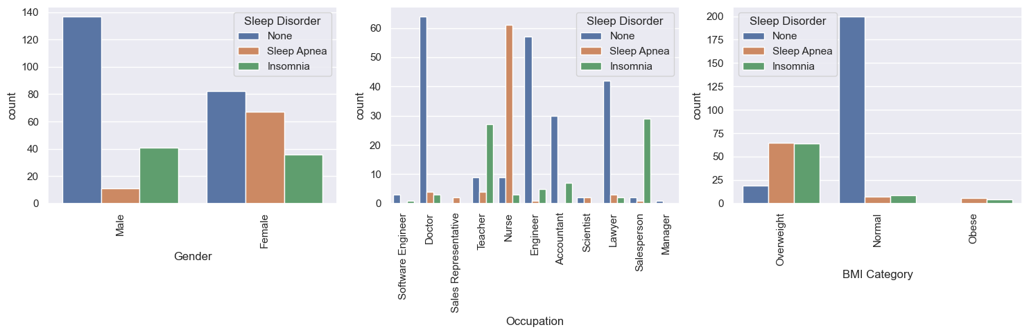
Dataset Analysis

Slide 11
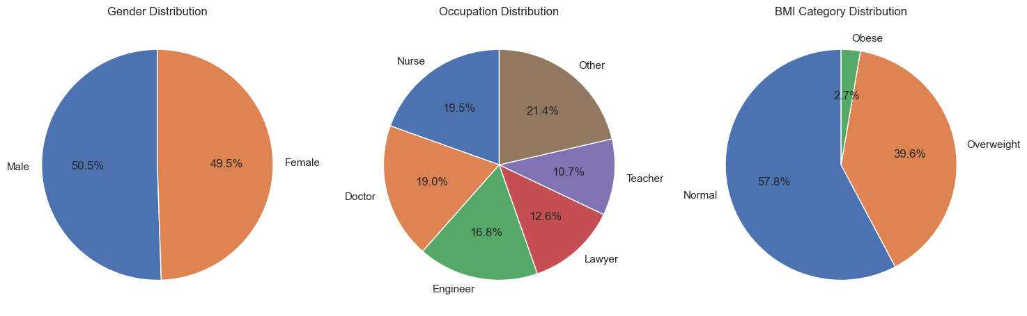
Dataset Analysis

Slide 12
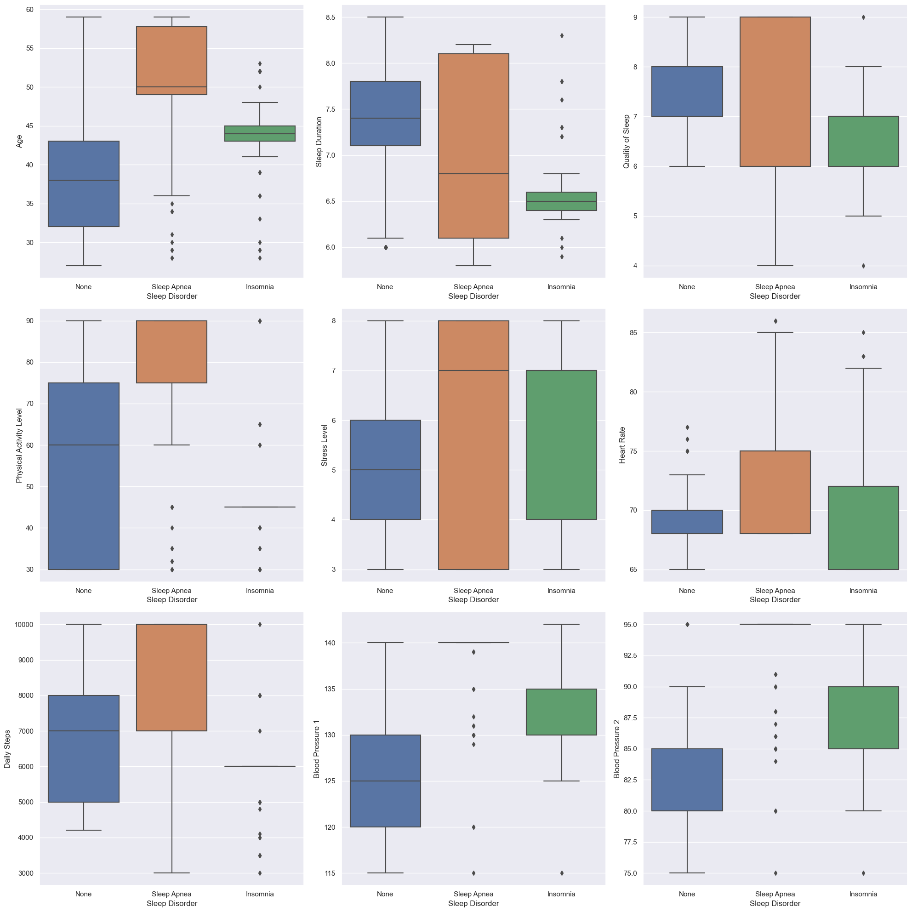
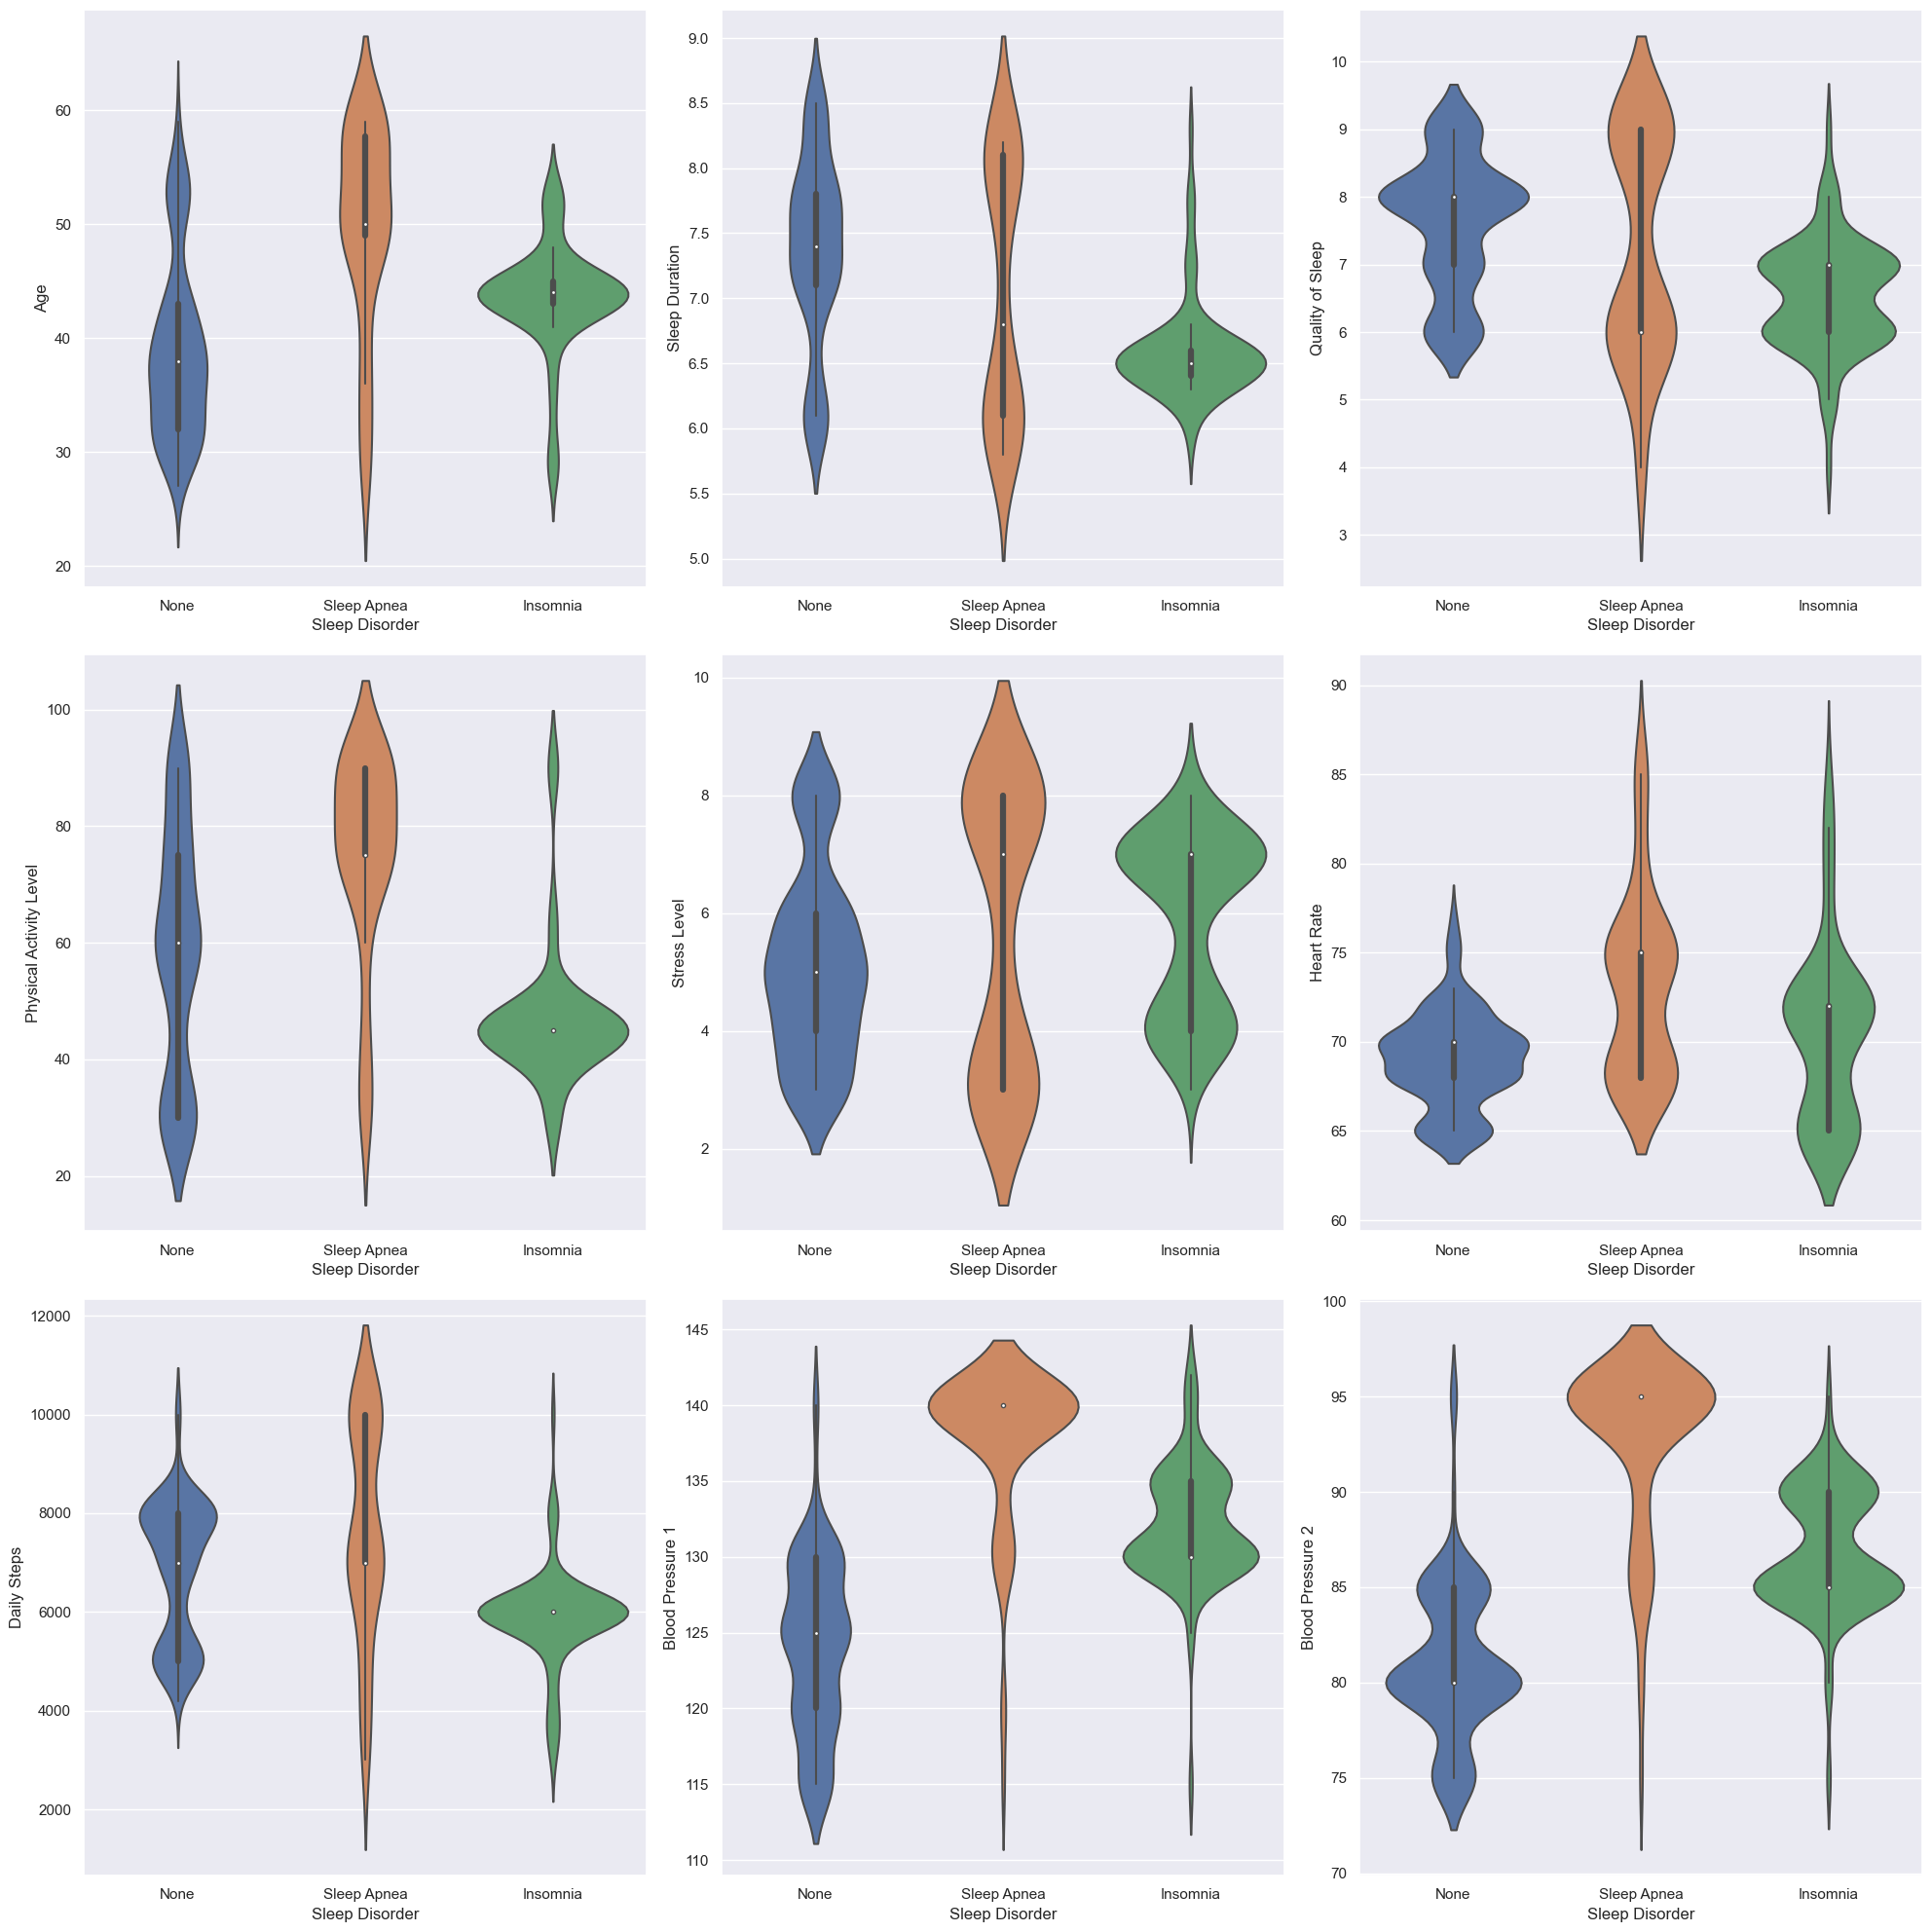
Dataset Analysis

Slide 13
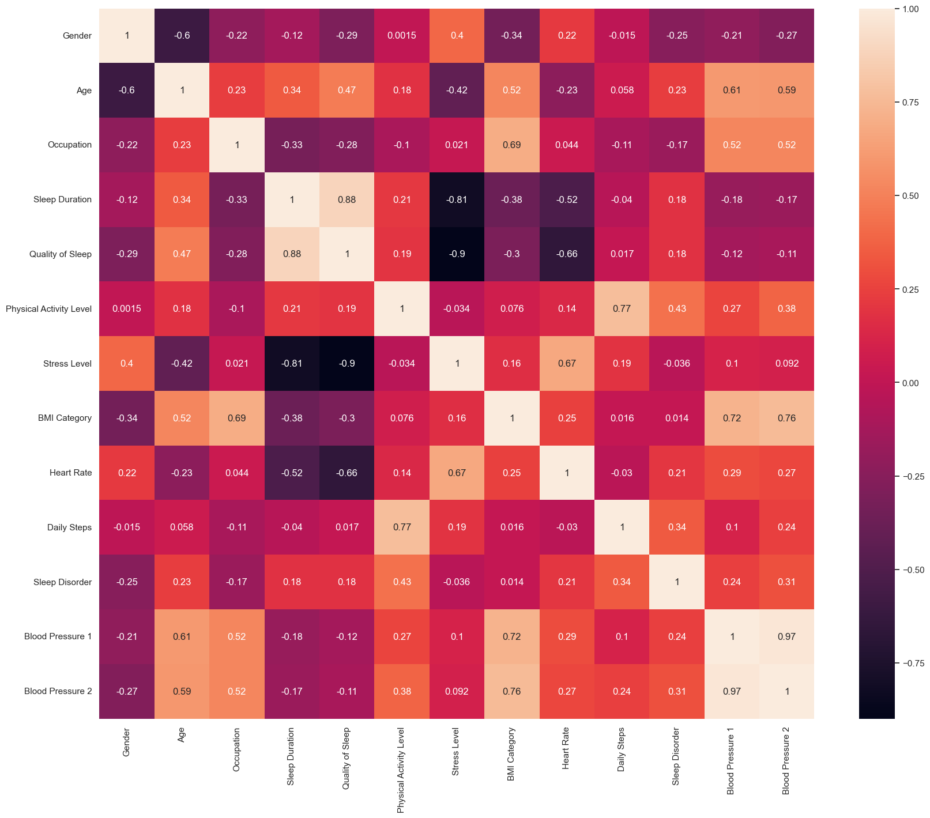
Dataset Analysis

Slide 14
Algorithm Design
Data Loading and Exploration: Load the dataset and examine its structure and initial rows.
Data Preprocessing: Identify and address any issues with object-type columns, such as checking unique values and dropping irrelevant columns.
Split Blood Pressure Column: Separate the 'Blood Pressure' column into systolic and diastolic pressure columns for analysis.
Clean BMI Category: Standardize the 'BMI Category' values, e.g., replacing 'Normal Weight' with 'Normal'.
Exploratory Data Analysis (EDA): Visualize distributions and relationships between variables and the target ('Sleep Disorder') using various plots like bar plots, histograms, and pie charts.

Slide 15
Algorithm Design
Data Post Processing: Handle missing values and perform label encoding for object-type columns.
Correlation Heatmap: Examine the correlation between numerical variables through a heatmap.
Model Training and Evaluation:
Train Decision Tree and Random Forest classifiers with hyperparameter tuning.
Assess model performance using metrics like accuracy, F1 score, precision, recall, Jaccard score, and confusion matrix.
Visualize feature importance using bar plots and SHAP summary plots for both models.

Slide 16
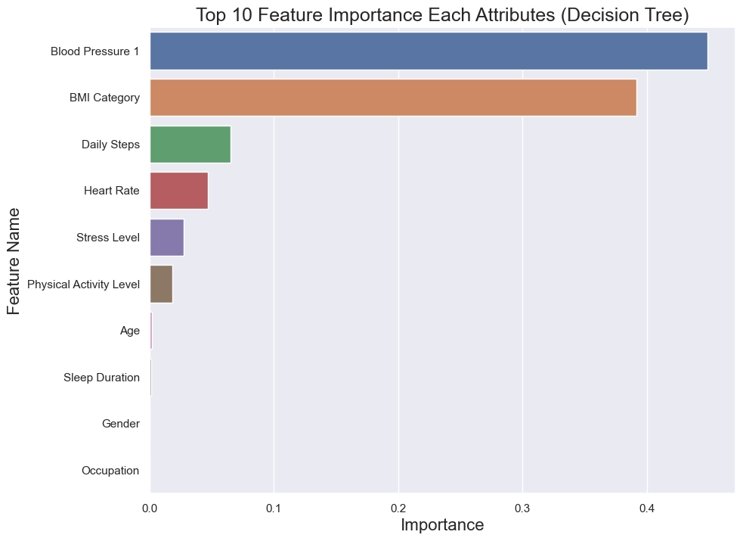
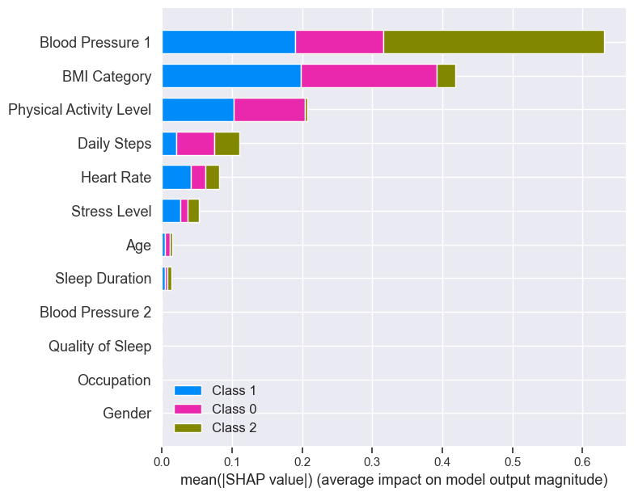
Model Evaluation

Slide 17
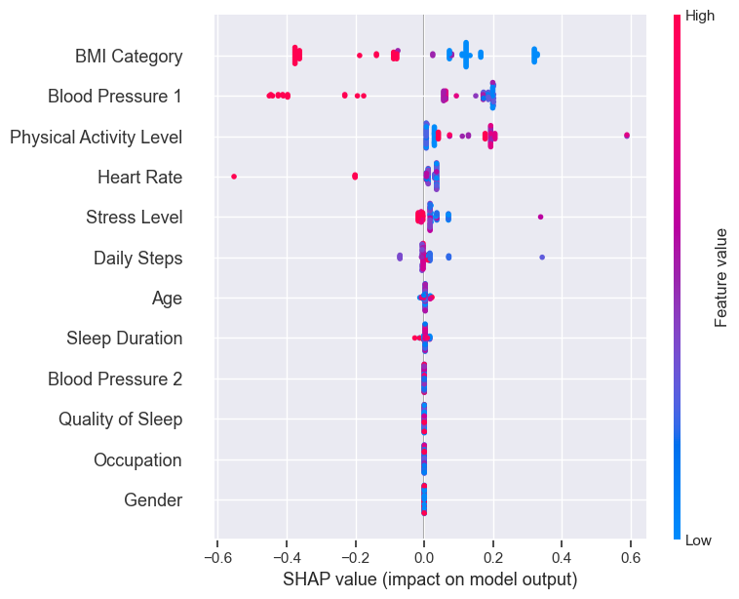
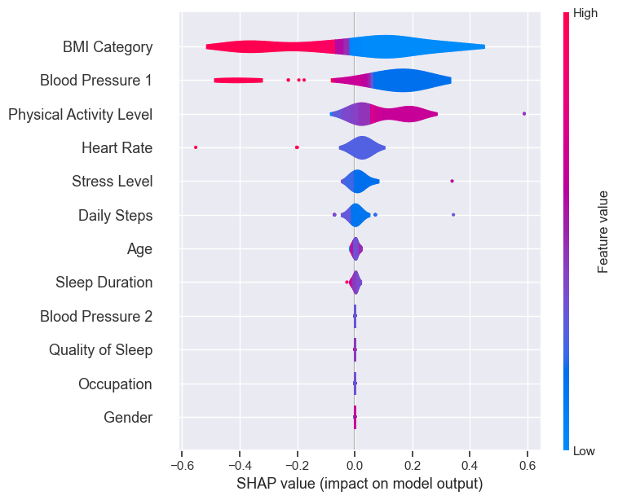
Model Evaluation

Slide 18
Result
The Random Forest Classifier achieved an F-1 Score of 0.88, indicating a strong balance between precision and recall.
The Precision Score and Recall Score are also 0.88, demonstrating the model's ability to correctly identify positive instances while minimizing false positives.
The Jaccard Score, a measure of similarity between predicted and true labels, is 0.79 indicates a good level of agreement between the predicted and actual outcomes.
The Accuracy Score of 88.0% further confirms the model's effectiveness in classifying sleep disorder cases.

Slide 19
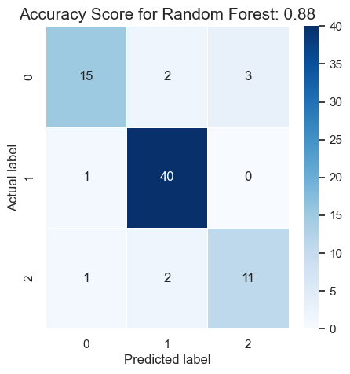
Conclusion
this project successfully developed and evaluated a Random Forest Classifier for predicting sleep disorders based on a comprehensive dataset encompassing various health and lifestyle attributes. The model exhibited strong performance metrics including an F-1 Score, Precision, Recall, Jaccard Score and accuracy Score indicates robust predictive capabilities.

Slide 20
Future Work
Model Refinement: Further fine-tuning of hyperparameters and exploration of different machine learning algorithms could potentially improve predictive performance.
Integration of Additional Data: Incorporating additional datasets or features, such as genetic data or environmental factors, may enhance the model's predictive capabilities and provide a more comprehensive understanding of sleep disorders.
Longitudinal Analysis: Conducting longitudinal studies to analyze changes in health and lifestyle factors over time and their impact on sleep disorders could provide deeper insights into disease progression and risk factors.

Slide 21
References
[1] Maniruzzaman, M., Rahman, M. J., Ahammed, B., & Abedin, M. M. (2020). Classification and prediction of diabetes disease using machine learning paradigm. Health information science and systems, 8, 1-14.
[2] Ali, M. M., Paul, B. K., Ahmed, K., Bui, F. M., Quinn, J. M., & Moni, M. A. (2021). Heart disease prediction using supervised machine learning algorithms: Performance analysis and comparison. Computers in Biology and Medicine, 136, 104672.
[3] Ali, F., El-Sappagh, S., Islam, S. R., Kwak, D., Ali, A., Imran, M., & Kwak, K. S. (2020). A smart healthcare monitoring system for heart disease prediction based on ensemble deep learning and feature fusion. Information Fusion, 63, 208-222.

Slide 22
Thank You

